Slide 1

School of Computer Engineering and Technology
Presentation for SY Minor Project (Review)
Student Feedback System
Students Name
Himanshu Sangale(251)
Siddhi D.Mankar (253)
Prajval Gandhi (257)
Guide:
Mr. Pradeep Katoch Sir

Slide 2
Index
Introduction
Project Overview
Problem Statement and Objectives
Proposed Block Diagram and it explanation
Methodology
References

Slide 3
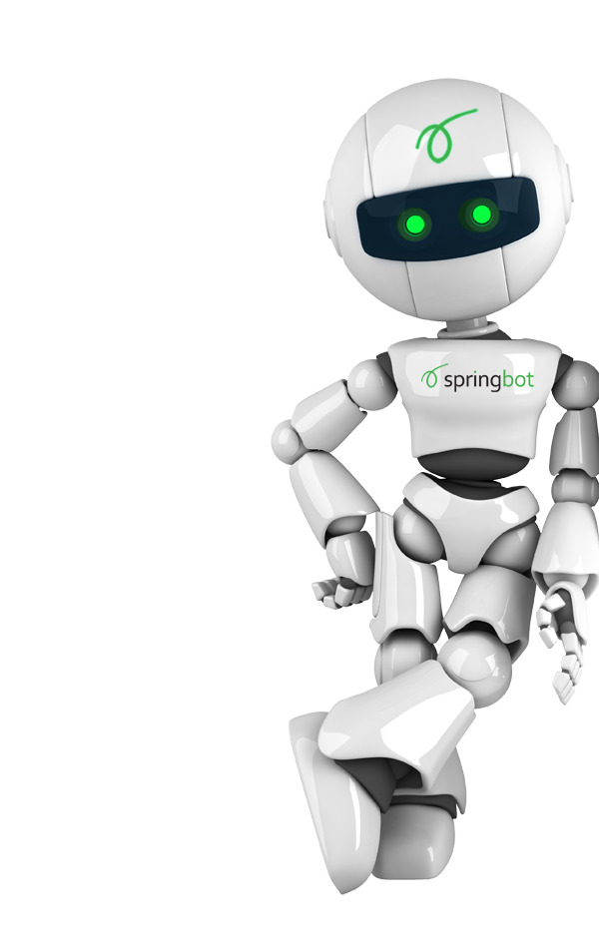
What is Feedback System?
a management information system for education establishments to manage student data
Student Feedback Systems provide capabilities for selecting particular subject for feedback
generate the report automatically
build student details, student-related data needs in a college.

Slide 4
Problem Statement
The feedback for faculty/Course in the current system i.e., google form is a manual process.
This is a time taking and inefficient process.
The collective data from the entire batch is difficult to comprehend
This project replaces this current system with an Online Feedback System.
Using this System , students can provide feedback to faculty or curse online.

Slide 5
Project Overview
The user logs into the system and fills the feedback
The passwords will be all encrypted for security
The data is collected from all the students to generate a consolidated report and the same can be downloaded as an excel or pdf
There is mapping with institute timetable which is benificial
Admin can import and export the data through excel
It would be easier method for admistration to organize and mine this data.

Slide 6
Methodology
Front End
HTML
CSS
JavaScript
Ajax
Backend
MySQL
PHP
Other Technologies
Excel:- PhpSpreadsheet
PDF:- Dompdf

Slide 7
Block Diagram For Data Structures Visualization
Sign In/Sign up
Student
Admin
Email Verification
Allocate Students
Allocate courses
Feedback Analysis
Feedback
Excel Module
Excel Module
PDF Module

Slide 8
Advantages
Same feedback form for all the teachers
Differentiate data between different departments
Mapping with timetable
A independent system
Email authentication

Slide 9
Thank A Ton!!
Any questions.

